Slide 1
Csedu banking management system
A banking management system using java, mysql and javafx
Instructors
DR. CHOWDHURY FARHAN AHMED
Professor, CSEDU
Redwan Ahmed Rizvee
Lecturer, CSEDU
Project By
Md. Abu Horaira (26)
Shraban Karmoker Avi (44)
Md. Adib Ahsan (60)

Slide 2




Project tools
For project structure: JAVA
For Graphical User Interface: JAVAFX, CSS
For DATA SAVING AND REUSE: MYSQL

Slide 3
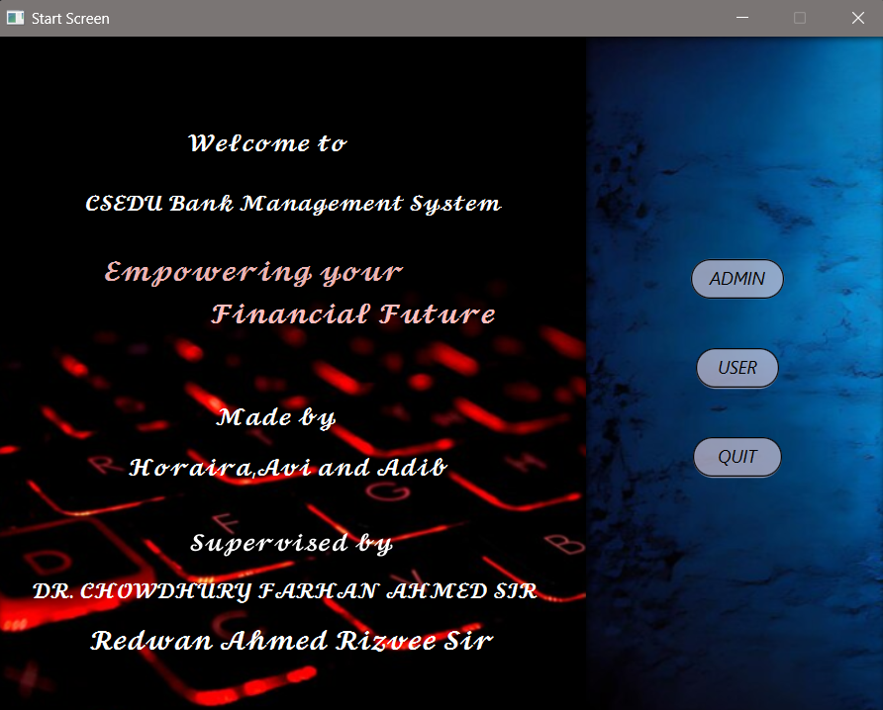
Project description - HOMe
Two types of user uses this app.
Admin
Customer
Three options in HomePage
“Admin” for admin queries
“User” for User queries
“Quit” for ending the program.
USERS
ADMIN
CUSTOMER

Slide 4
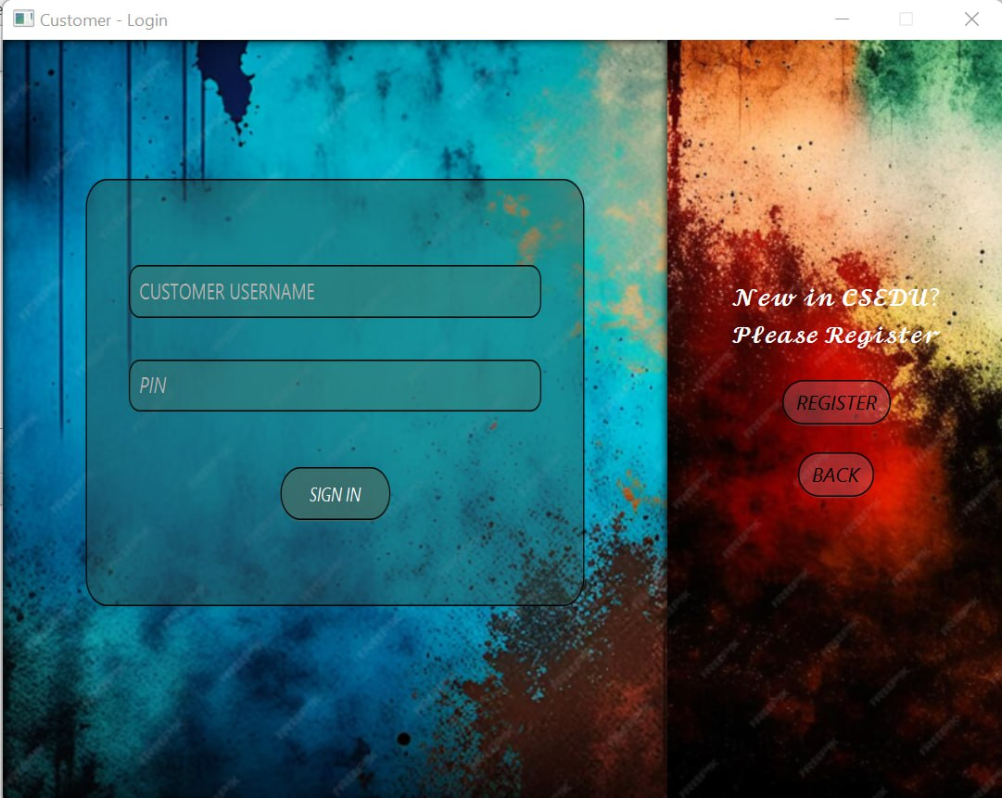
Project description - login
Login Page for both customer and admin. Input will be cross checked with database data. Also they can open new account.
Login Page

Slide 5
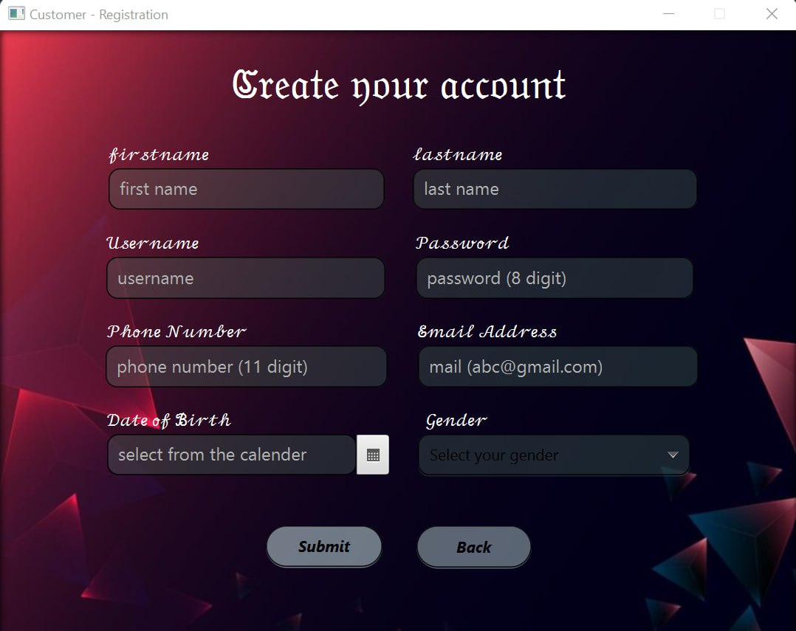
Project description - registration
Registration page for admin and customer. There are some validation added.
Username must be minimum 3 character
Email should contains @gmail.com followed by minimum 3 characters
Phone Number must be 11 digits.
Password must be 8 digits.

Slide 6
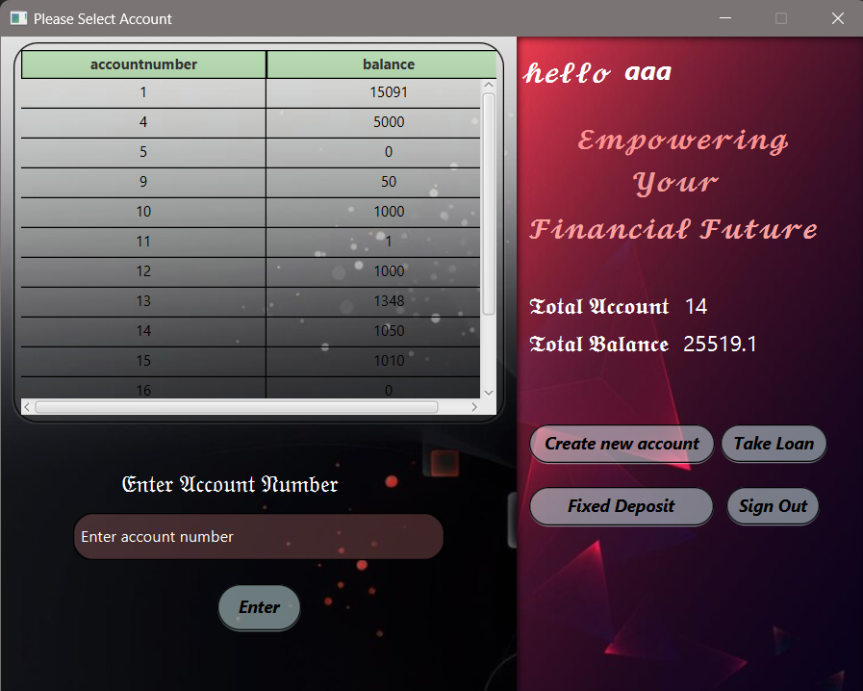
Project description – account selection
In this page customer can open a new normal account, see his balance, accounts details, open fixed deposit account, open loan account, go back to the previous menu, enter one of the customer account.

Slide 7
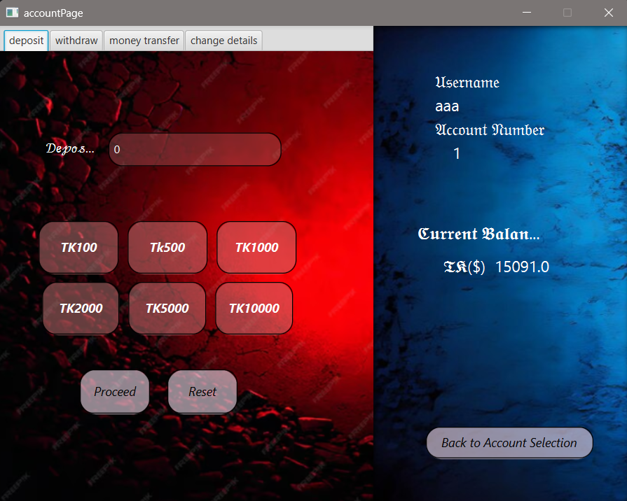
Project description –Deposit Transaction
Customer can deposit money to account. It can be done by the template selection or input value.

Slide 8
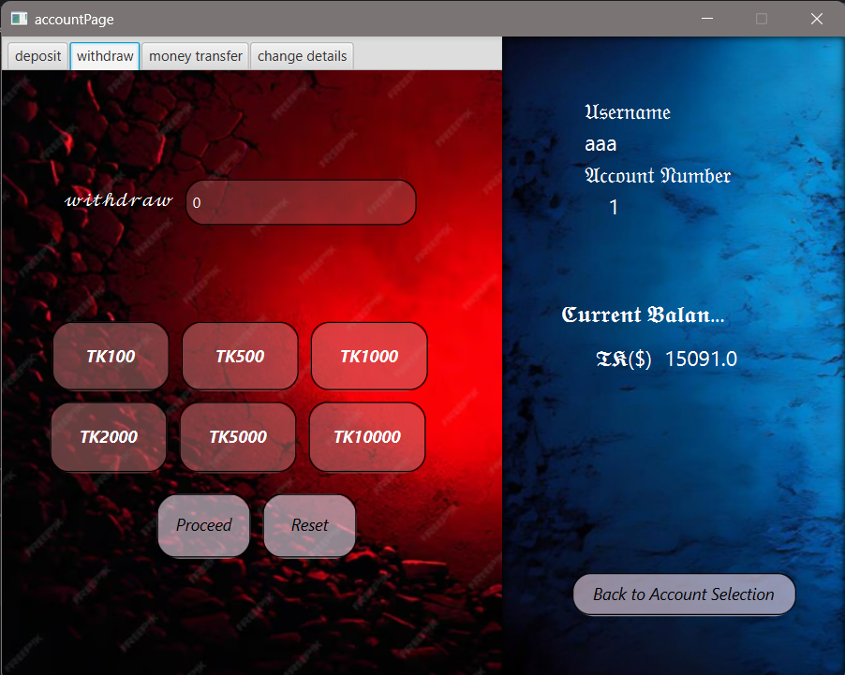
Project description – Withdraw Transaction
In this page customer can withdraw money from account. From template or giving input.

Slide 9
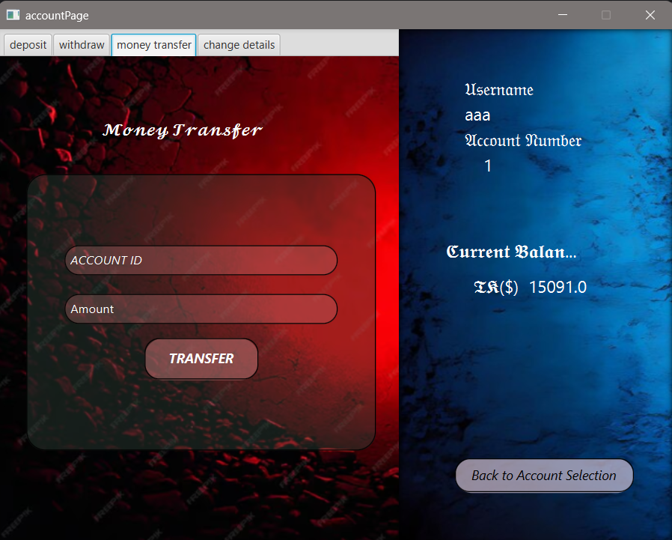
Project description – transfer transaction
In this page customer can transfer money from this account to any of the customer account or another customer account.

Slide 10
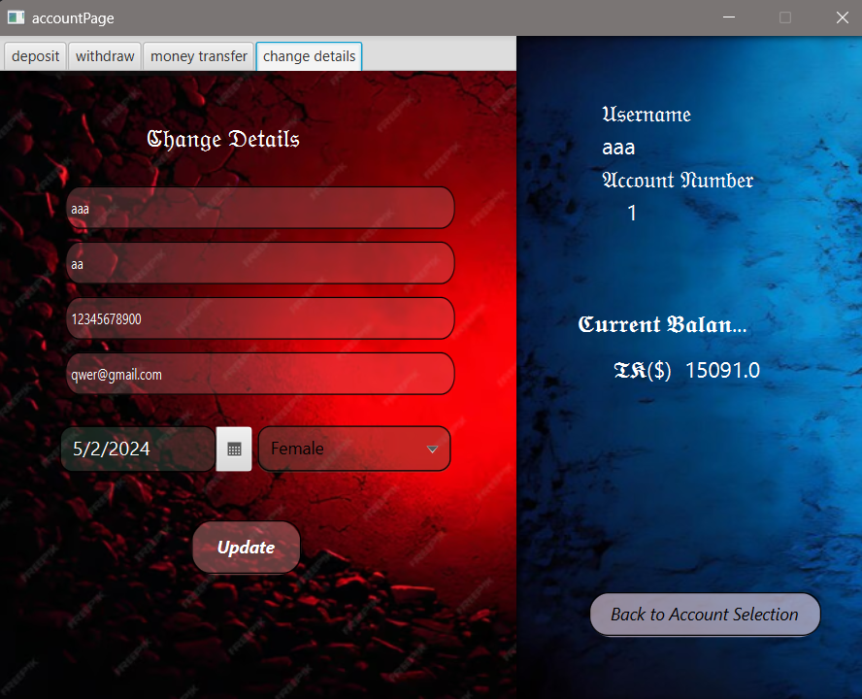
Project description – Update details
In this page customer can update details.

Slide 11
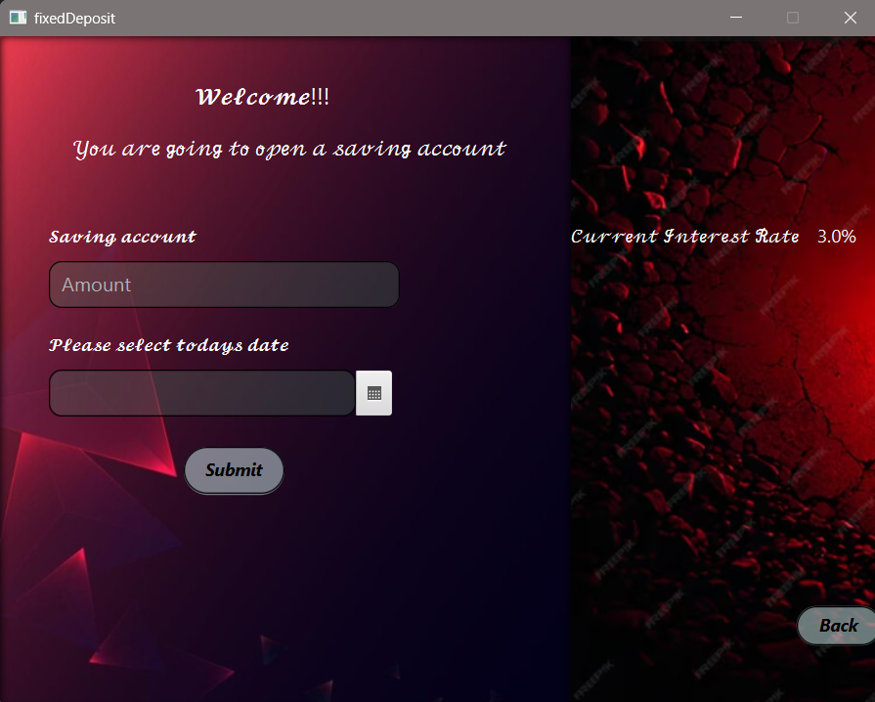
Project description – Fixed deposit
Customers can open a fixed deposit account with interest rate (3% in this case).
Fixed Deposit amount can be used as Bank’s Balance and other customer can take loan from this balance.

Slide 12
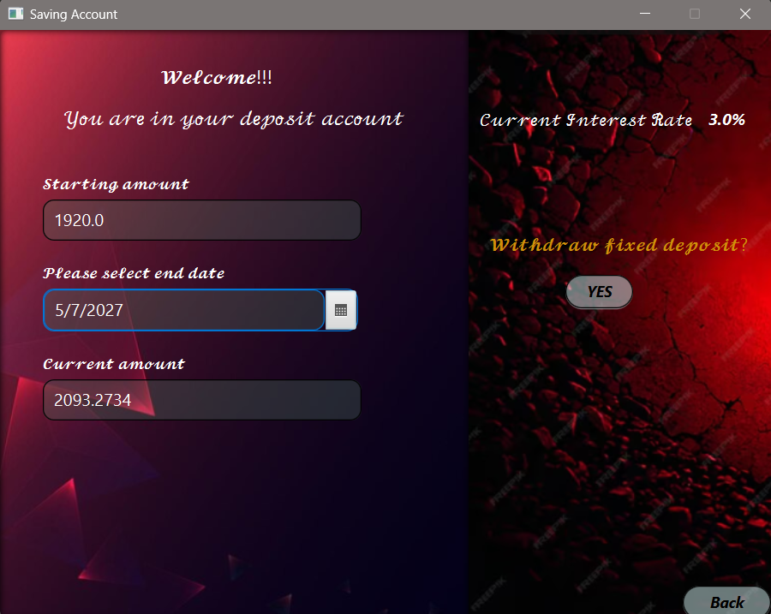
Project description – Fixed deposit withdraw
Customer can withdraw money from fixed deposit. In this case they will receive some interest from Bank

Slide 13
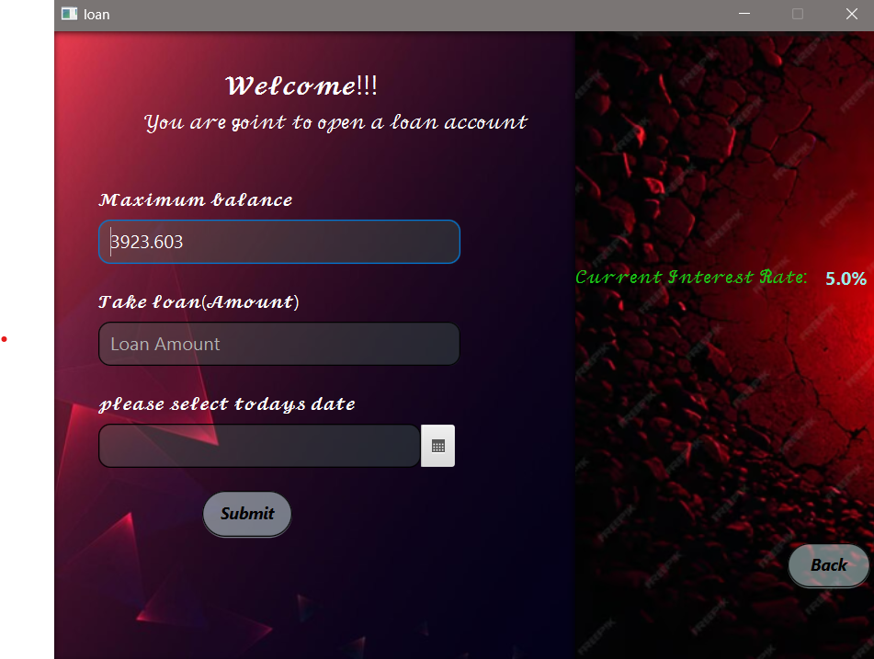
Project description - LOAN
Customer can take loan from Bank’s balance with a certain value of interest.

Slide 14
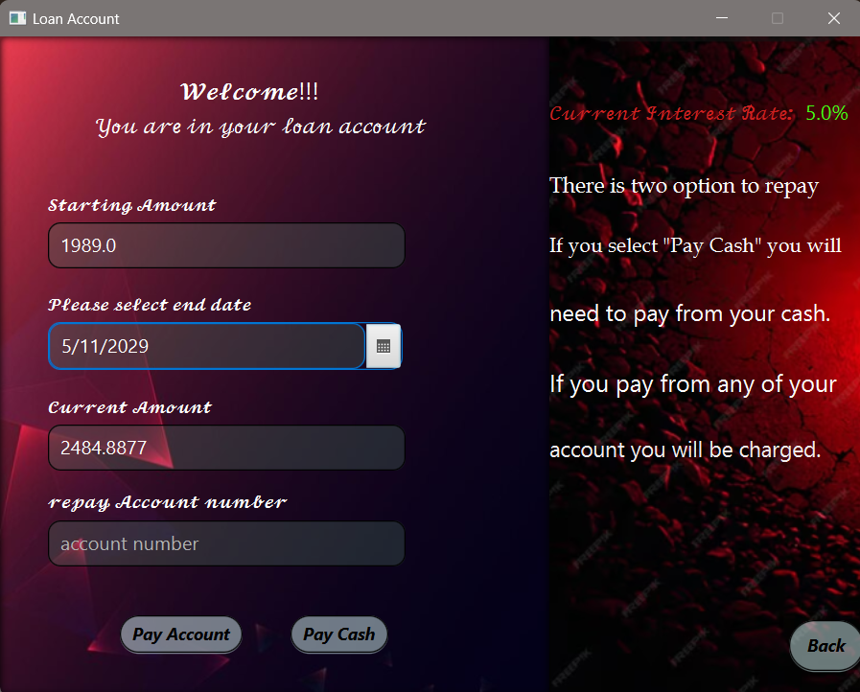
Project description – LOAN Repay
Customer can repay the loans.
There is two way to repay loans.
Pay Cash : In this way customer need to pay amount in cash with interest. The interest amount will be added with Bank Balance
Pay Account : In this way money will be repaid from the customers selected account.

Slide 15
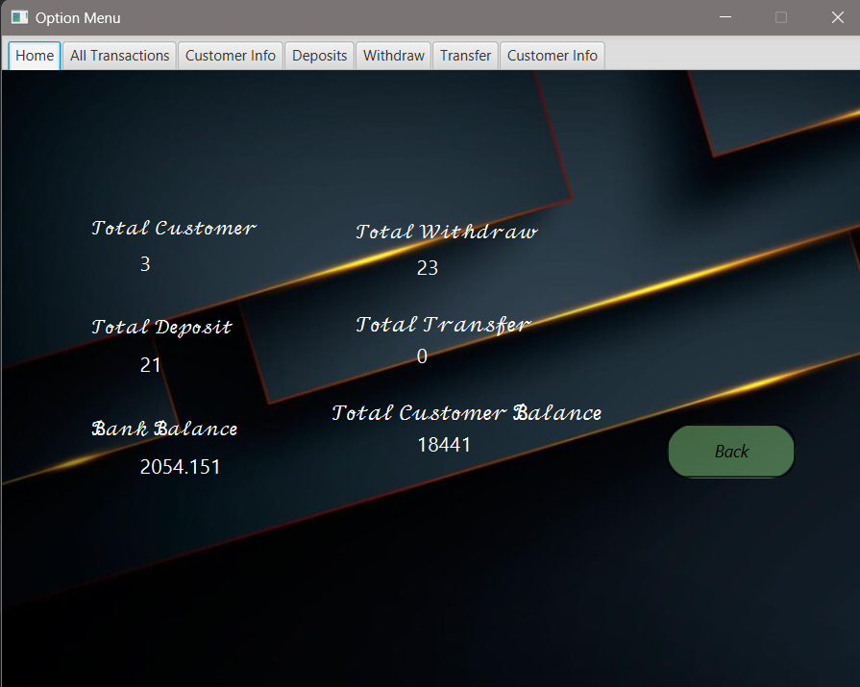
Project description – Admin page 1
Admin Home page.
Here admin can view all the information.
Total Customer
Total Withdraw
Total Deposits
Total Transfer
Bank Balance
Total Customer Balance

Slide 16
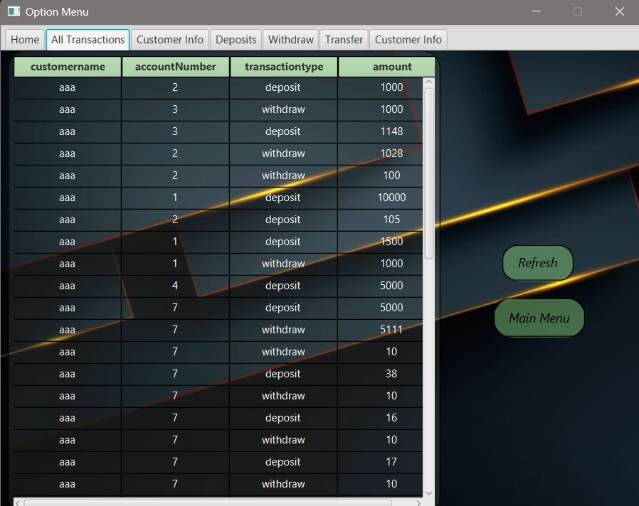
Project description – admin page 2
‘ALL TRANSACTIONS’ page shows all the transactions of this bank

Slide 17
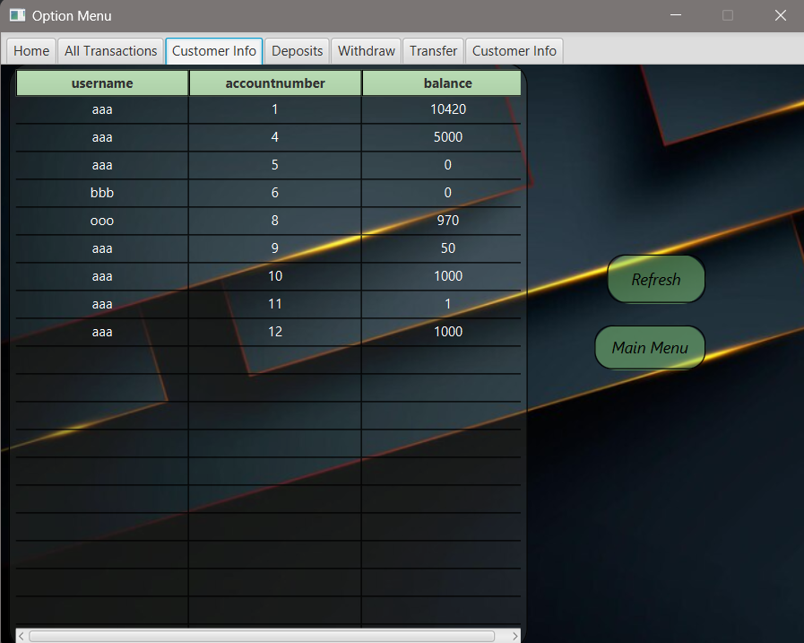
Project description – admin page 3
‘Customer info’ page shows all the customer info

Slide 18
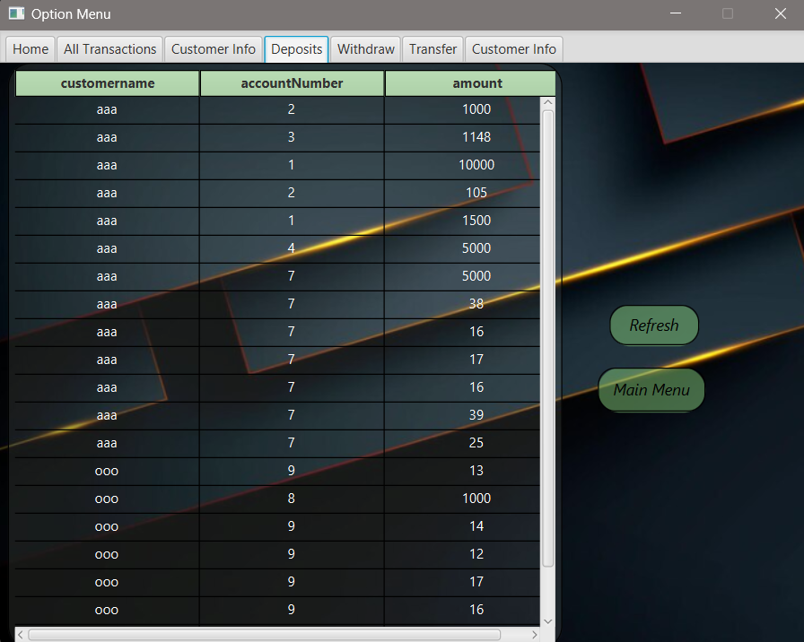
Project description – admin page 4
‘Deposits’ page shows all the deposit transaction of bank.

Slide 19
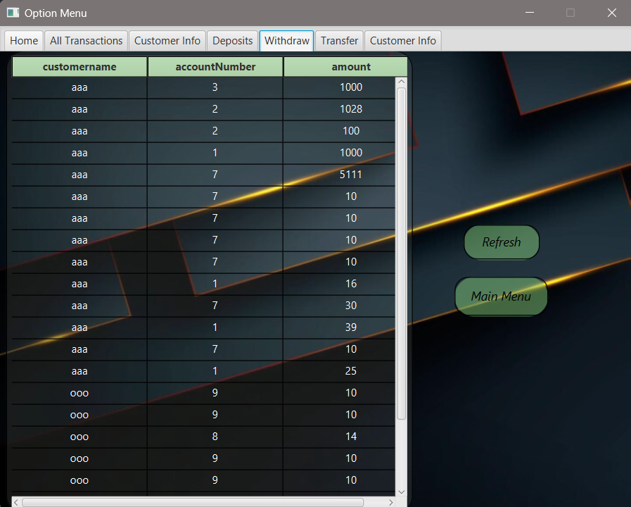
Project description – admin page 5
‘Withdraw’ page shows all the withdraw transaction of Bank

Slide 20
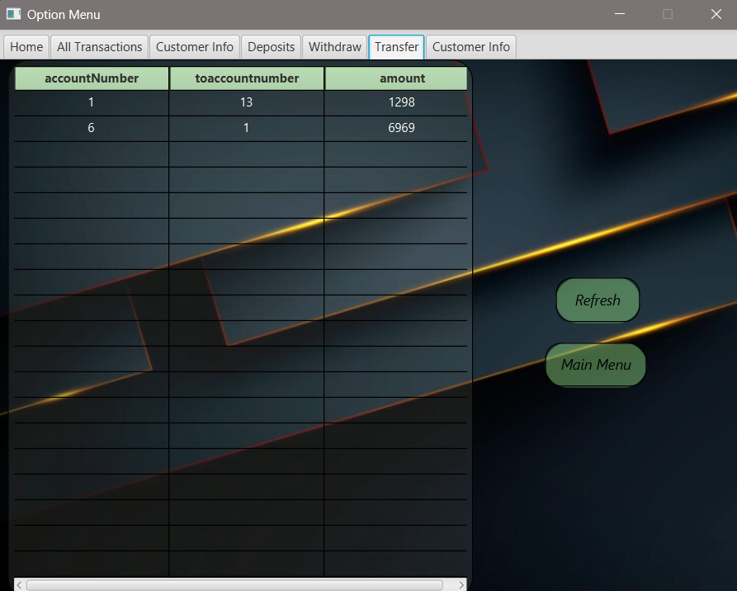
Project description – admin page 6
‘Transfer’ page shows all the transfer transaction.

Slide 21
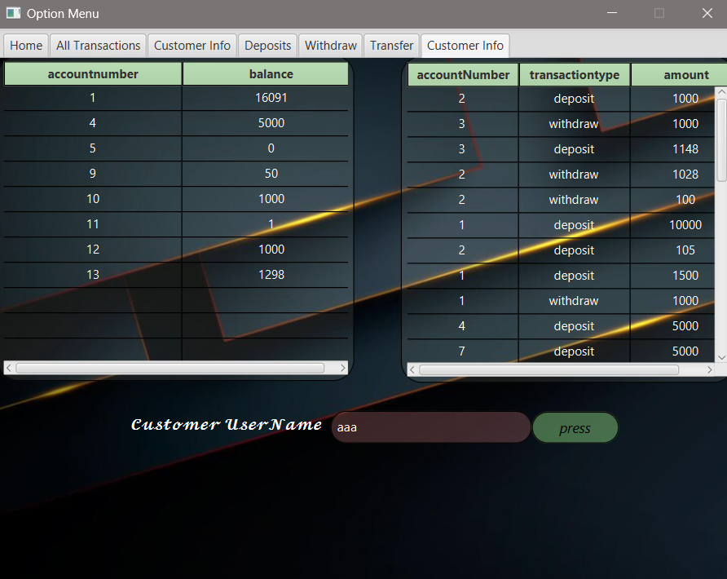
Project description – admin page 7
‘Customer info’ shows all the information about a customer.

Slide 22
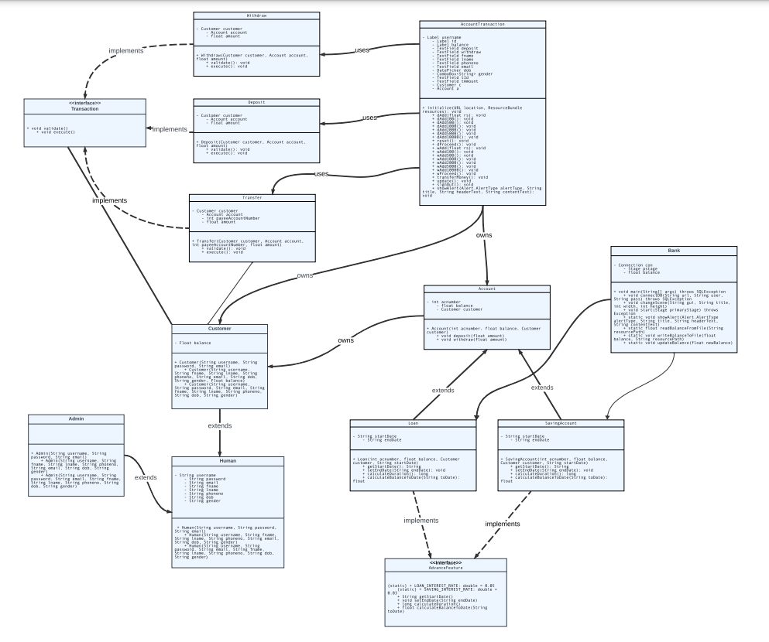
UML DIAGRAM

Slide 23
SUMMARY

Slide 24
QUESTIONS

Slide 25
THANK YOU

